Slide 1
Appeals to class politics
Fred und Davide
SICCS 2023, Berlin
13th July

Slide 2
Motivation
Research Questions
Change in class voting
Increased competition for working class vote
How does politicians’ rhetoric appeal to “class politics”? How does it change
.1 over time
.2 by ideological position
.3 in different contexts

Slide 3
Case selection
Presidential Debates
  1960-2020
  Primary & General
  Democratic and Republican
Other options not chosen:
  Candidate websites
  Congress member websites (press releases, newsletters)
  Another website with presidential debates:
- few cases
- more standardized

Slide 4
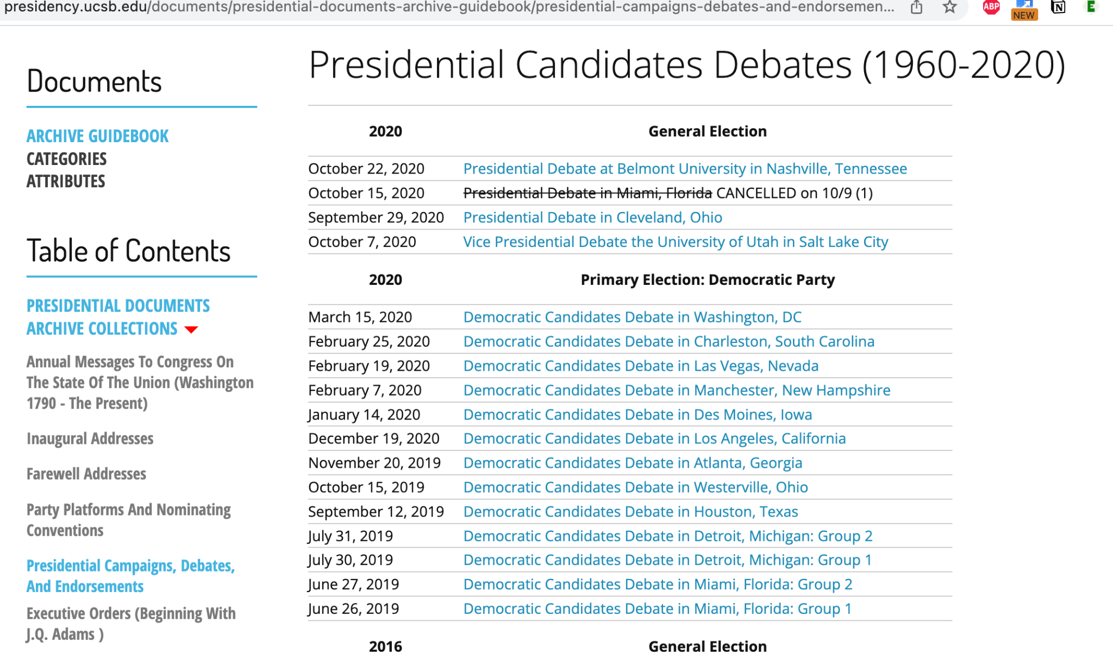
Web scraping

Slide 5
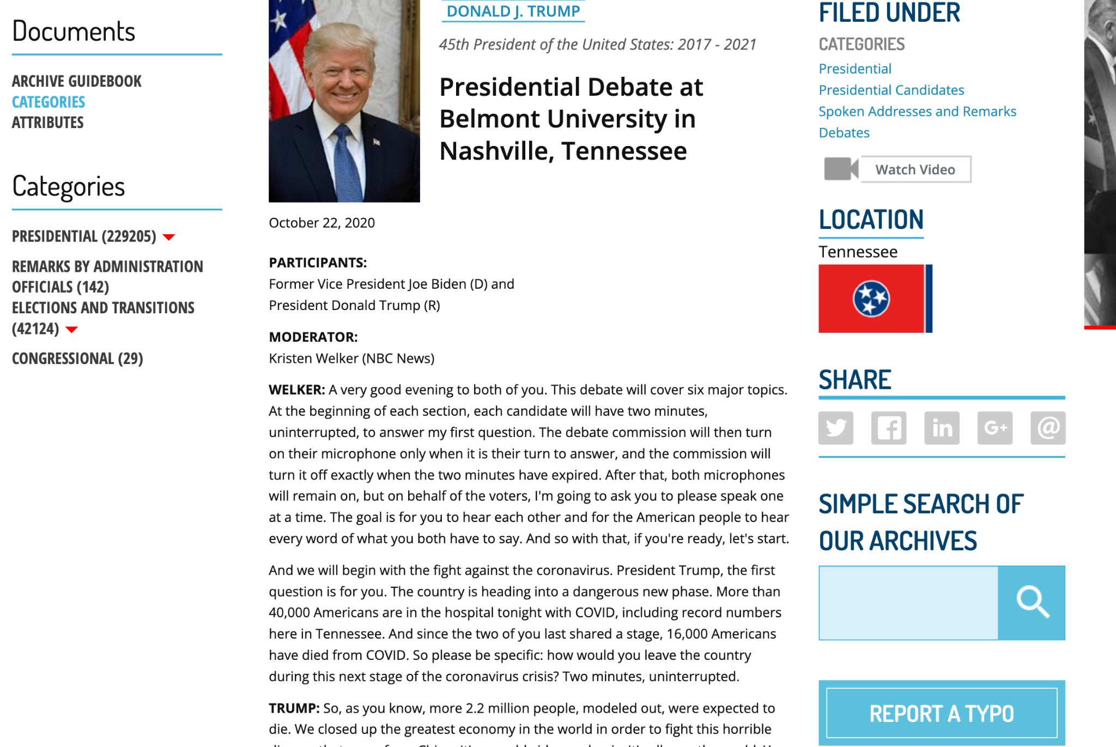

Slide 6
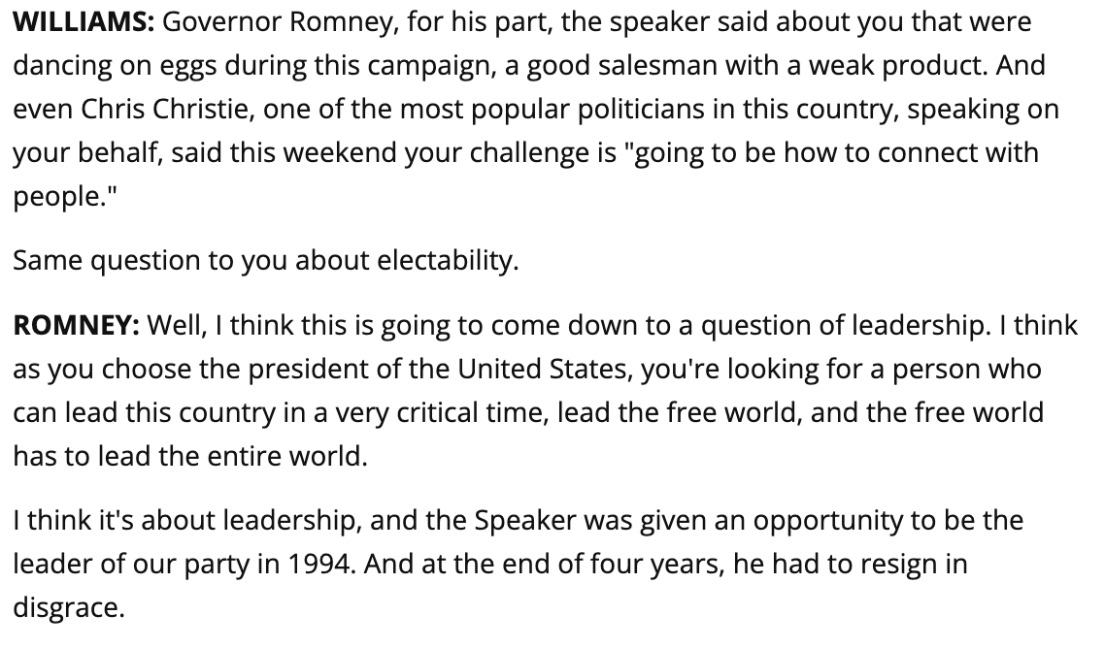

Slide 7
SPEAKER
TEXT
Williams
NA
Romney
NA

Slide 8
SPEAKER
TEXT
Williams
Williams
Romney
Romney

Slide 9

COLON
“:”
BOLD
<strong>, <b>
ITALICS
<em>, <i>
CAPITAL
[A-Z]
PERIOD
“.”

Slide 10
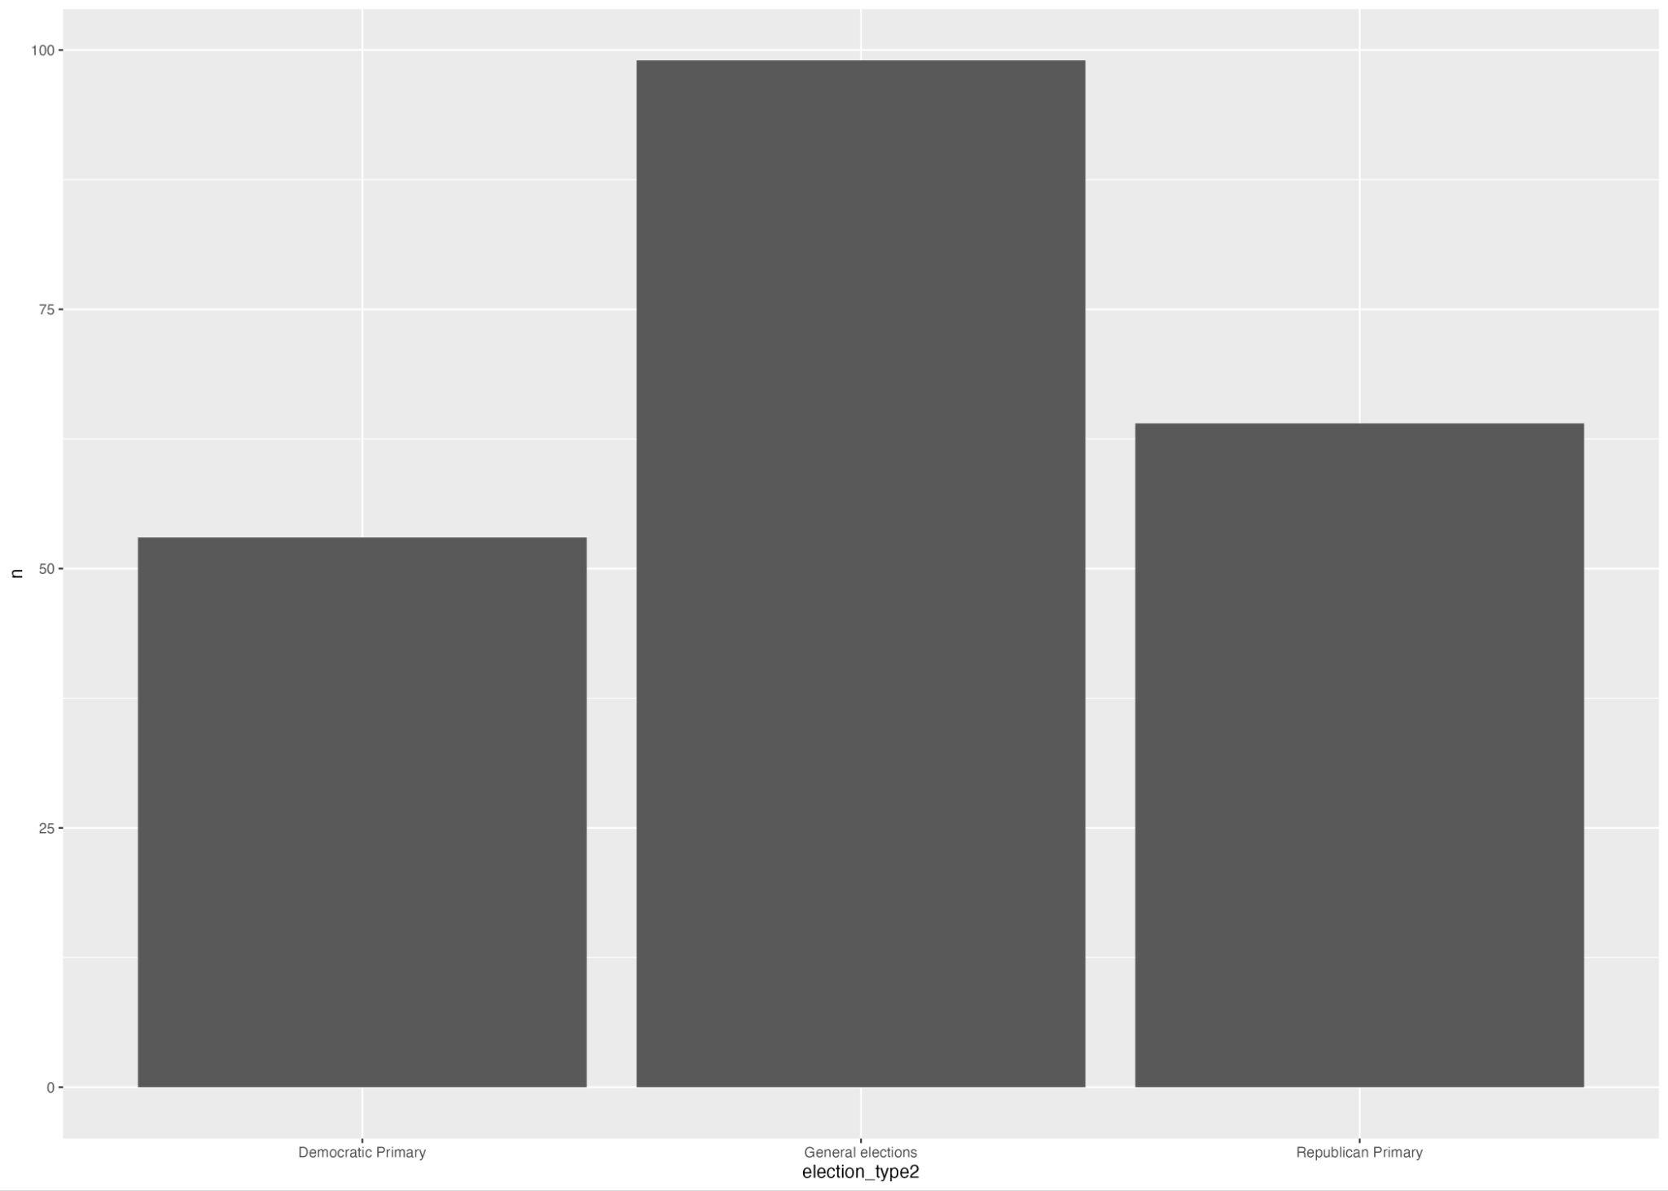
Data
Total number of debates: 166
Democratic Primary: 53
General elections: 99
Republican Primary: 64

Slide 11
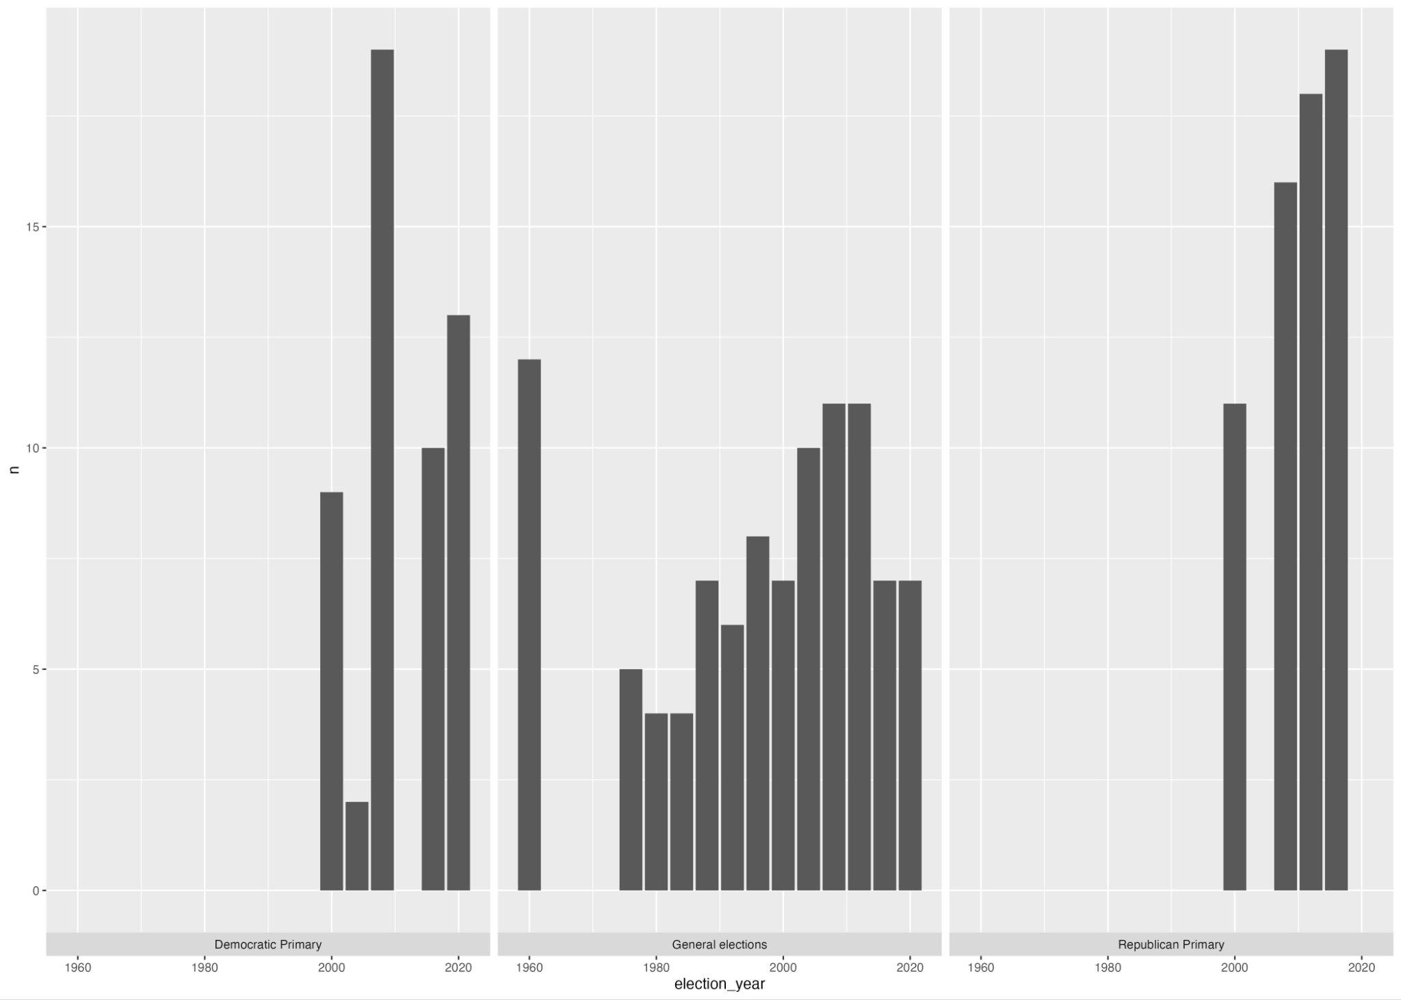
Number of speeches by year of election and type of election

Slide 12
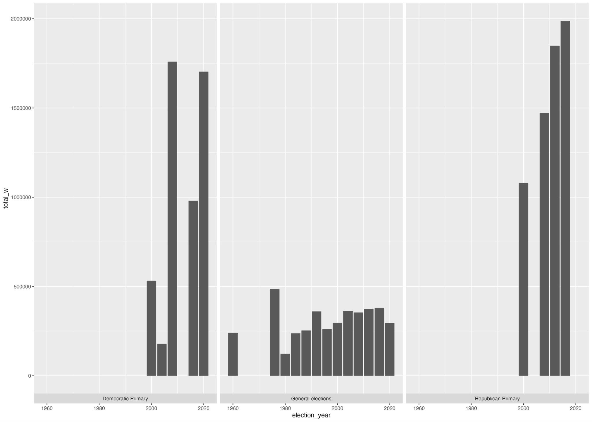
Number of words by year of election and type of election

Slide 13
Analysis 1: The dictionary
workers <- c(“worker”)
working_people <- c(“Working people”, “Working families”, “Working Americans”, “working American”, “working poor”, “blue collar”, “blue-collar”, “wage-earners”)
working_class <- c(“working class”, “Working-class”)
Aggregated in a generic working-class related dictionary
political_elites <- c(“political elite” , “power elite”, “career politician” , “career-politician” , “washington insider” , “political insider” , “professional politician”)
economic_elites <- c(“upper class”, “the rich “, “the wealthy”, “upper-class” , “wealthy interests” , “ultra wealthy” , “ultra-wealthy” ,“super rich” , “super-rich” , “mega-rich”,“wealthy few”, “privileged few” , “priveleged class” , “economic elite” , “People at the top” , “those at the top”, “millionaire”, “billionaire”, “top 1%” , “top 0.1 percent” , “top 1 percent” , “top one percent” , “the 1%” , “the 0.1 percent” , “the 1 percent” , “the one percent” , “richest 1%” , “richest 0.1 percent” , “richest 1 percent” , “richest one percent” , “wealthiest 1%” , “wealthiest 0.1 percent” , “wealthiest 1 percent” , “wealthiest one percent”)
Aggregated in a generic anti-elite related dictionary
! Need for a weight: count of the dictionary words used / count of the total words used

Slide 14
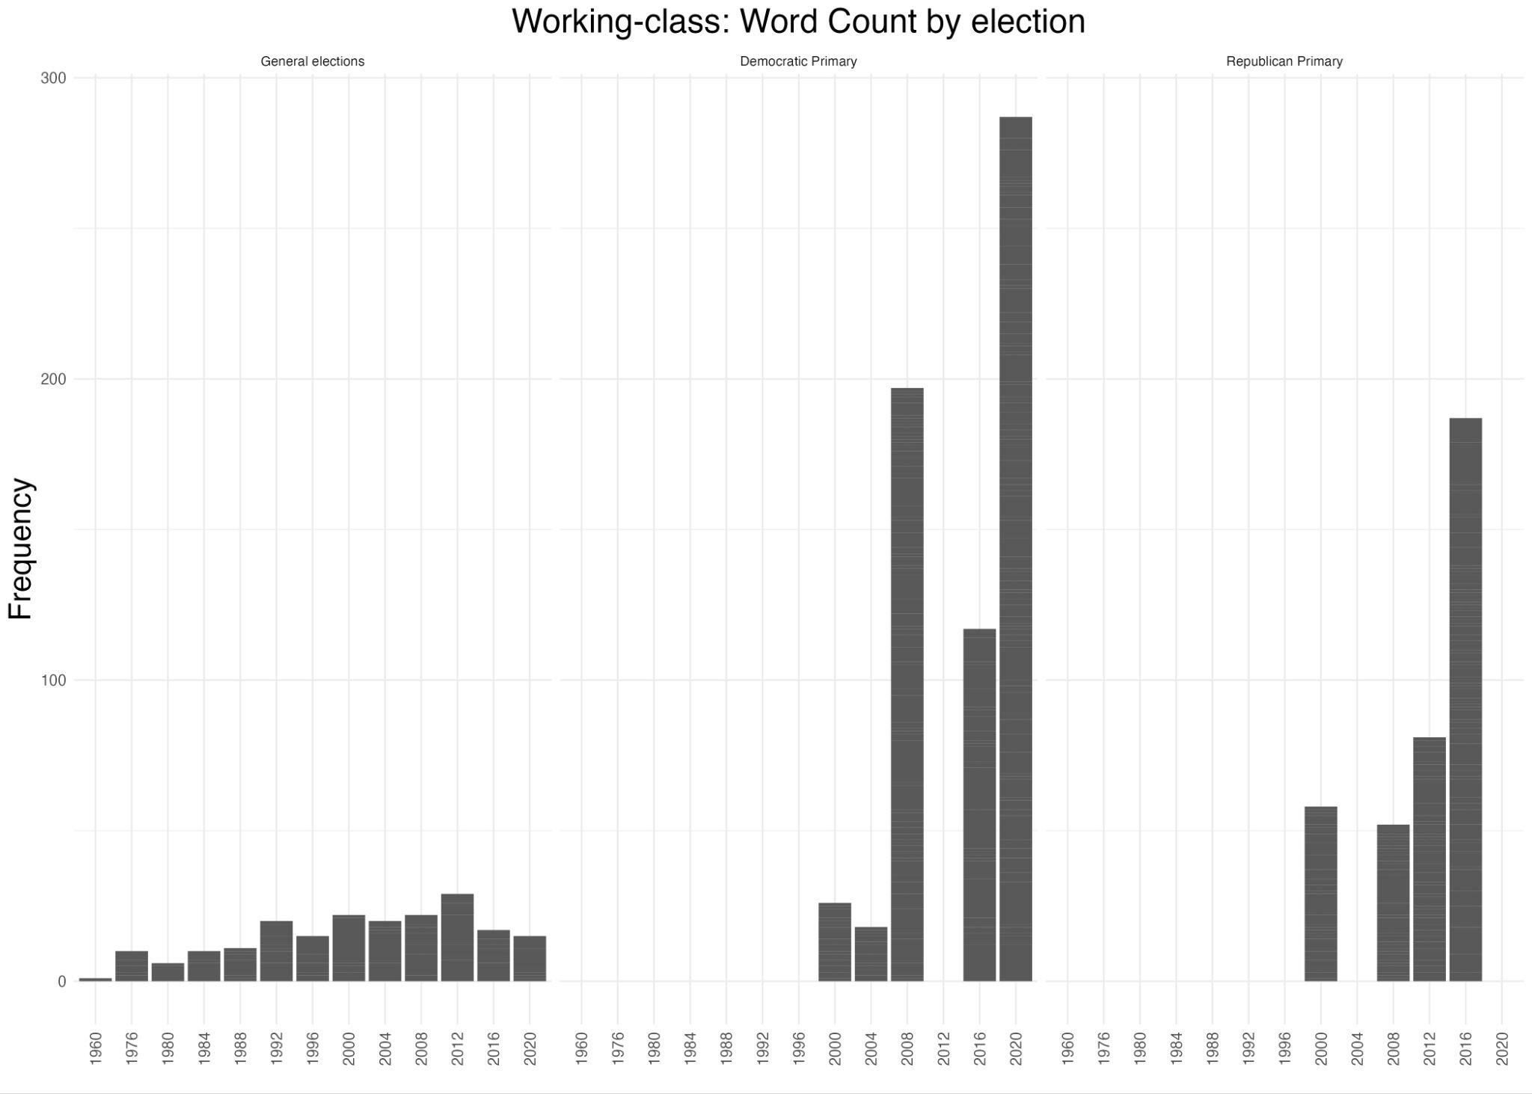
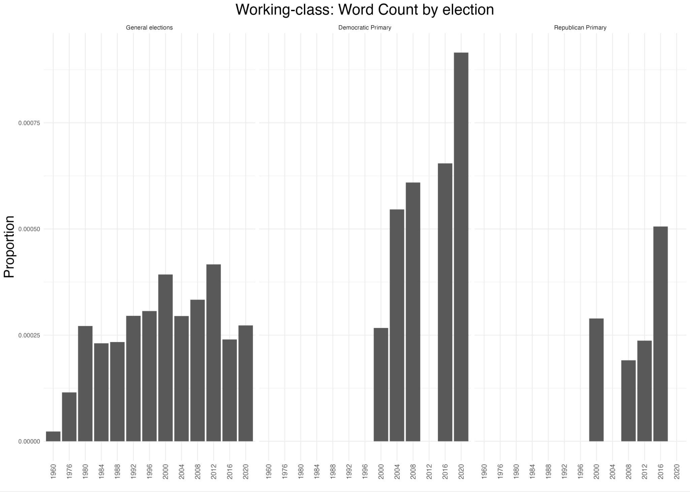
Working-class related dictionary

Slide 15
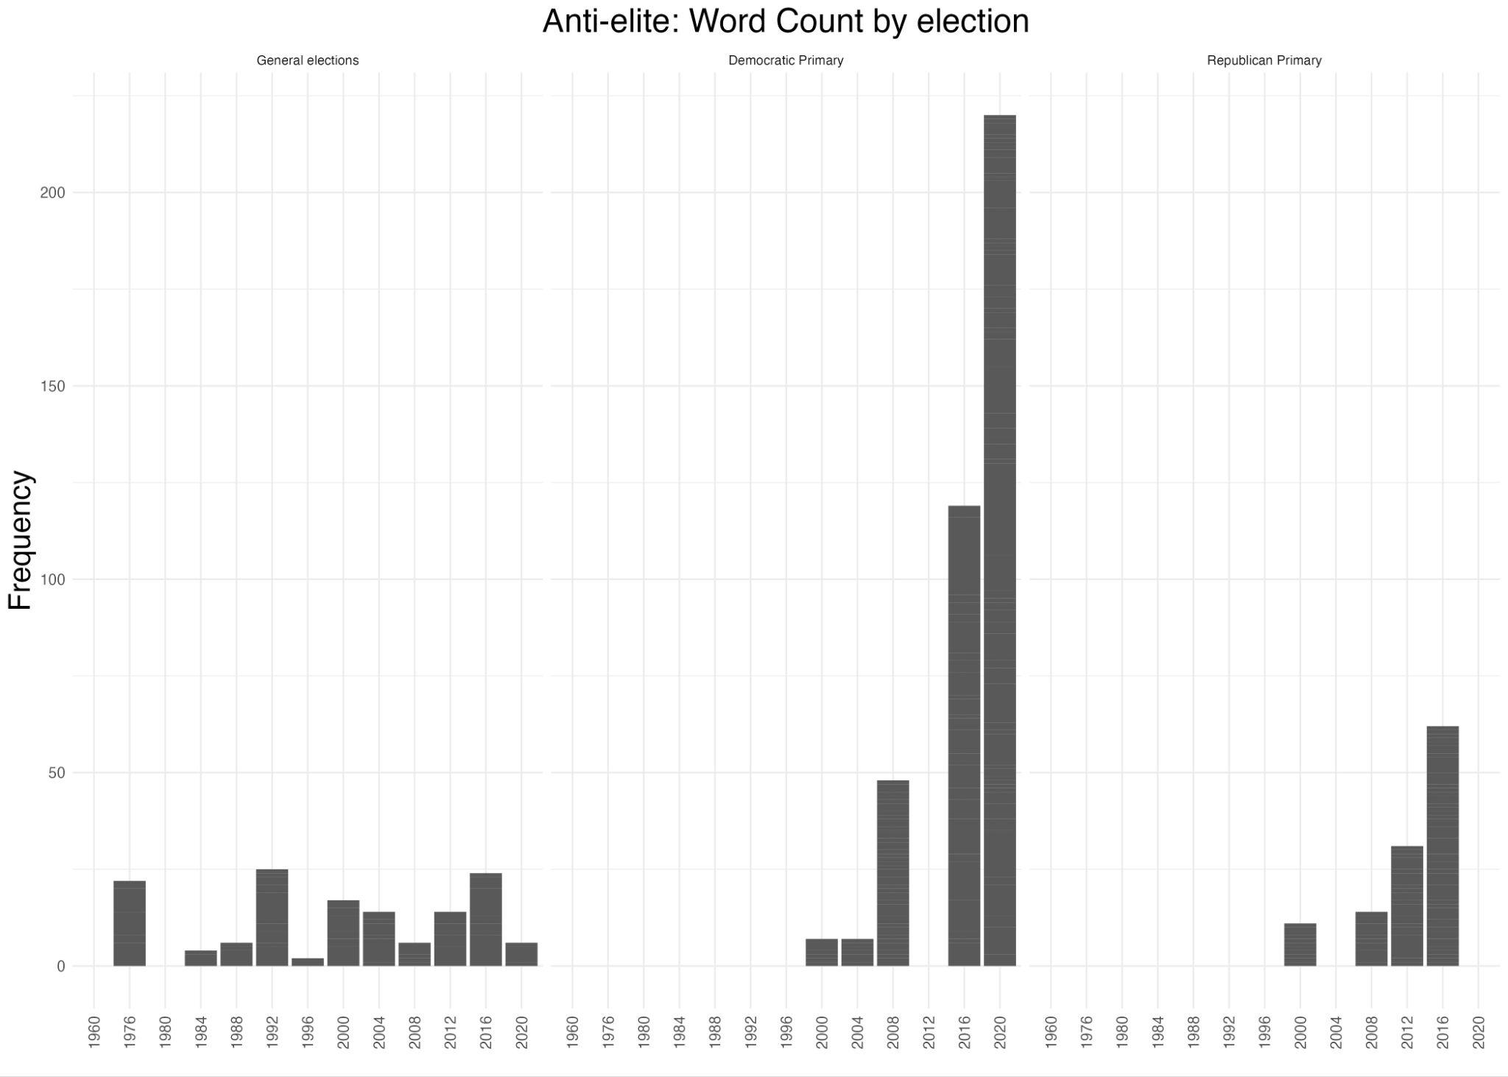
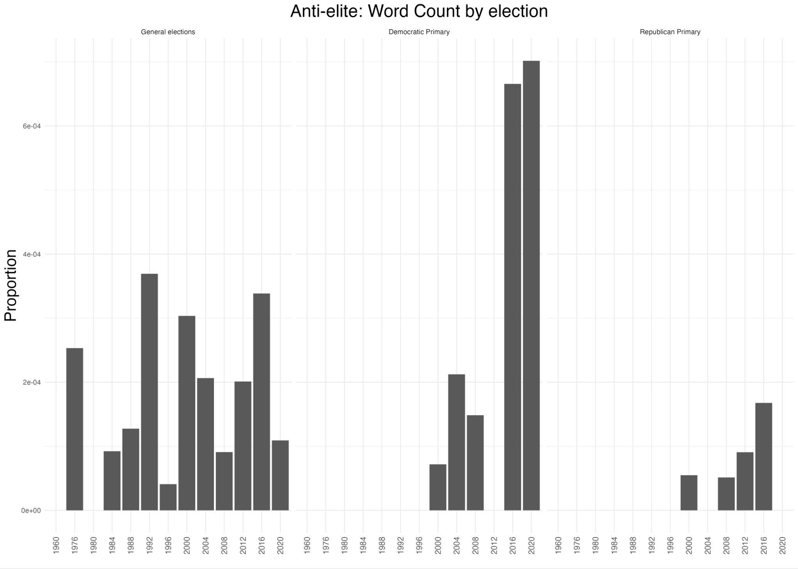
Anti-elite related dictionary

Slide 16
Analysis 2: Words Embedding≈
Problem with dictionary:
  Biased
  Non-comprehensive
Solution:
  use word embedding to “discover” relevant dictionary

Slide 17
Q1: What are the co-contextual words for “working class” and “anti-elite” concepts?
Divide corpus into Dem and Rep
Train word embeddings
Combine vectors to create concepts:
Working + Class
Wealthy + Elite

Slide 18
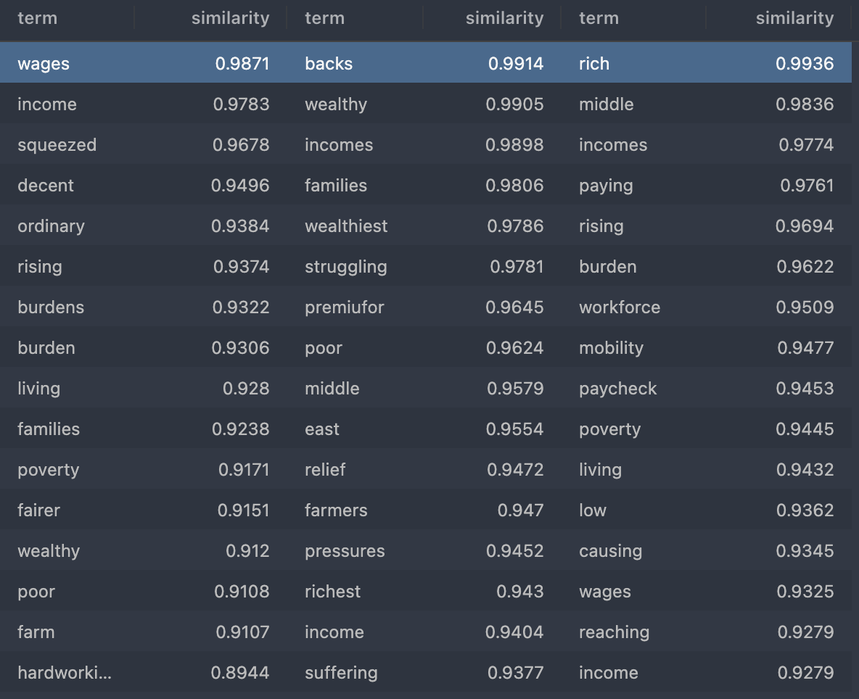
Working + Class
ALL CORPUS
DEM CORPUS
REP CORPUS

Slide 19
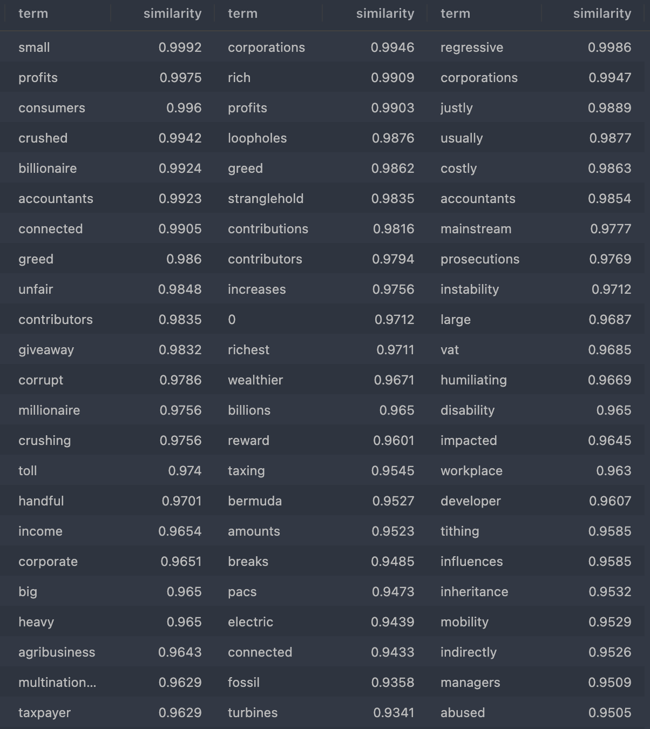
Wealthy + Elite
ALL CORPUS
DEM CORPUS
REP CORPUS

Slide 20
Q2: Which “texts” are most closely related to the two concepts? (working class, anti-elite)
Similarity Score = weighted frequency of “similar words”.
Alternative option: use pre-trained word embeddings
  Didn’t Work.

Slide 21
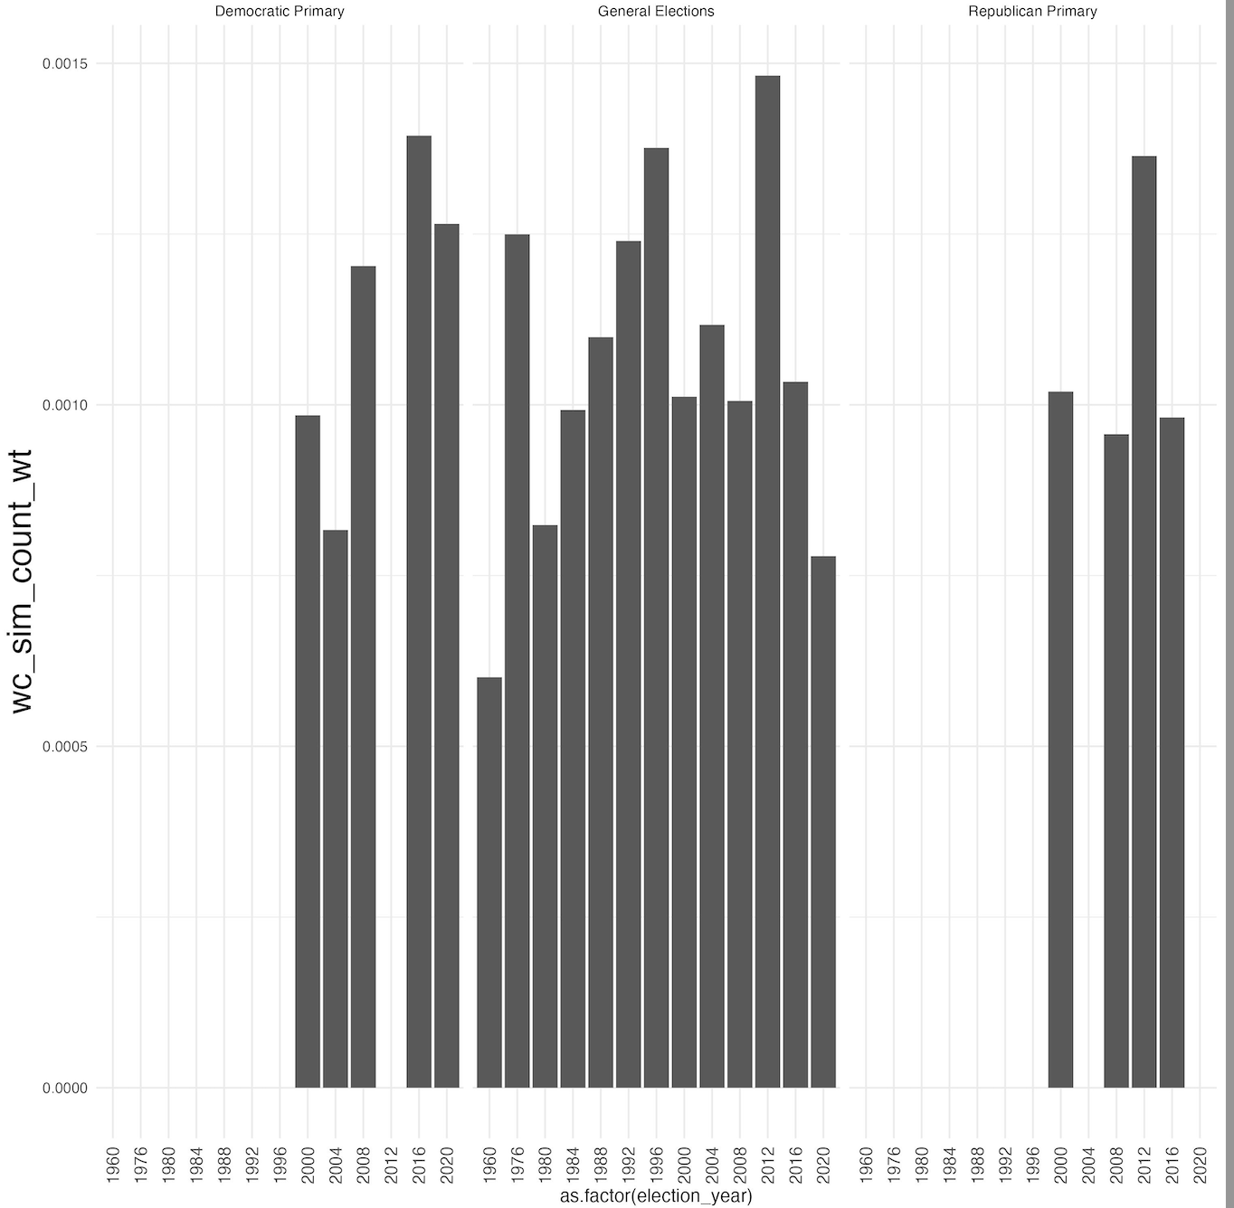
Working + Class

Slide 22
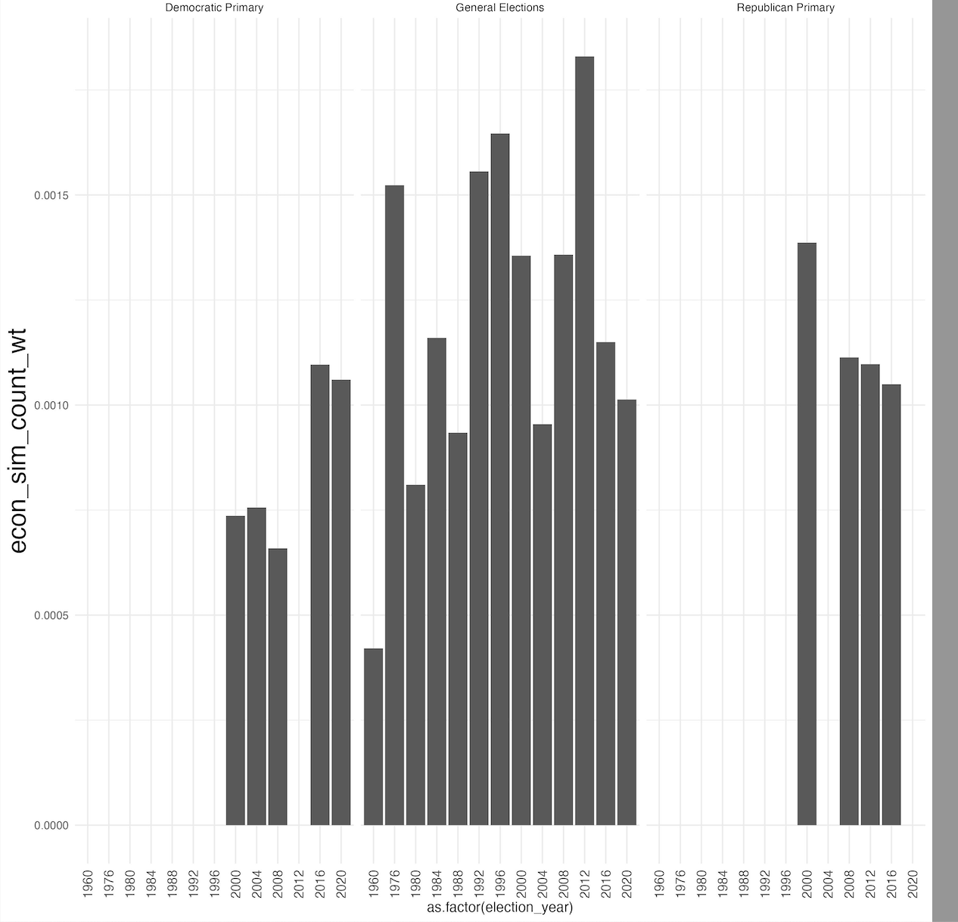
Wealthy + Elite

Slide 23
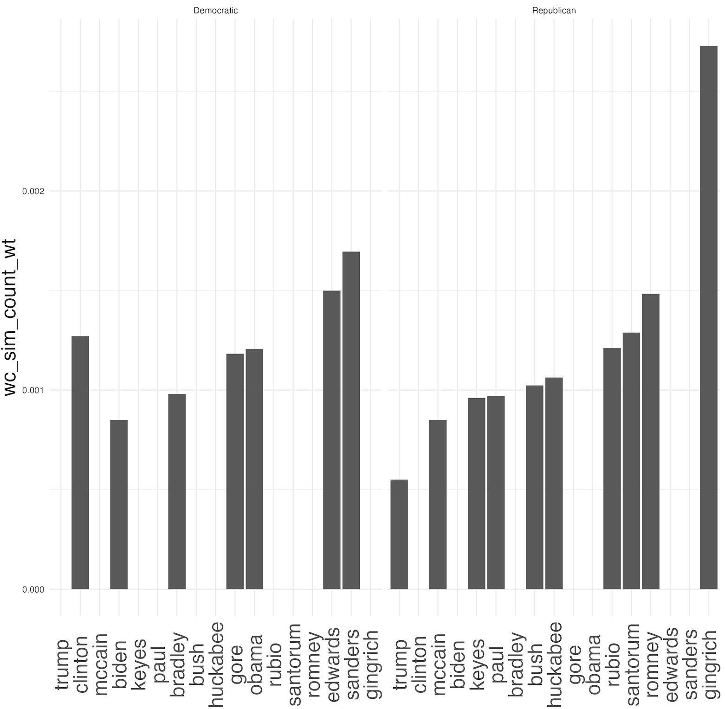
Working + Class

Slide 24
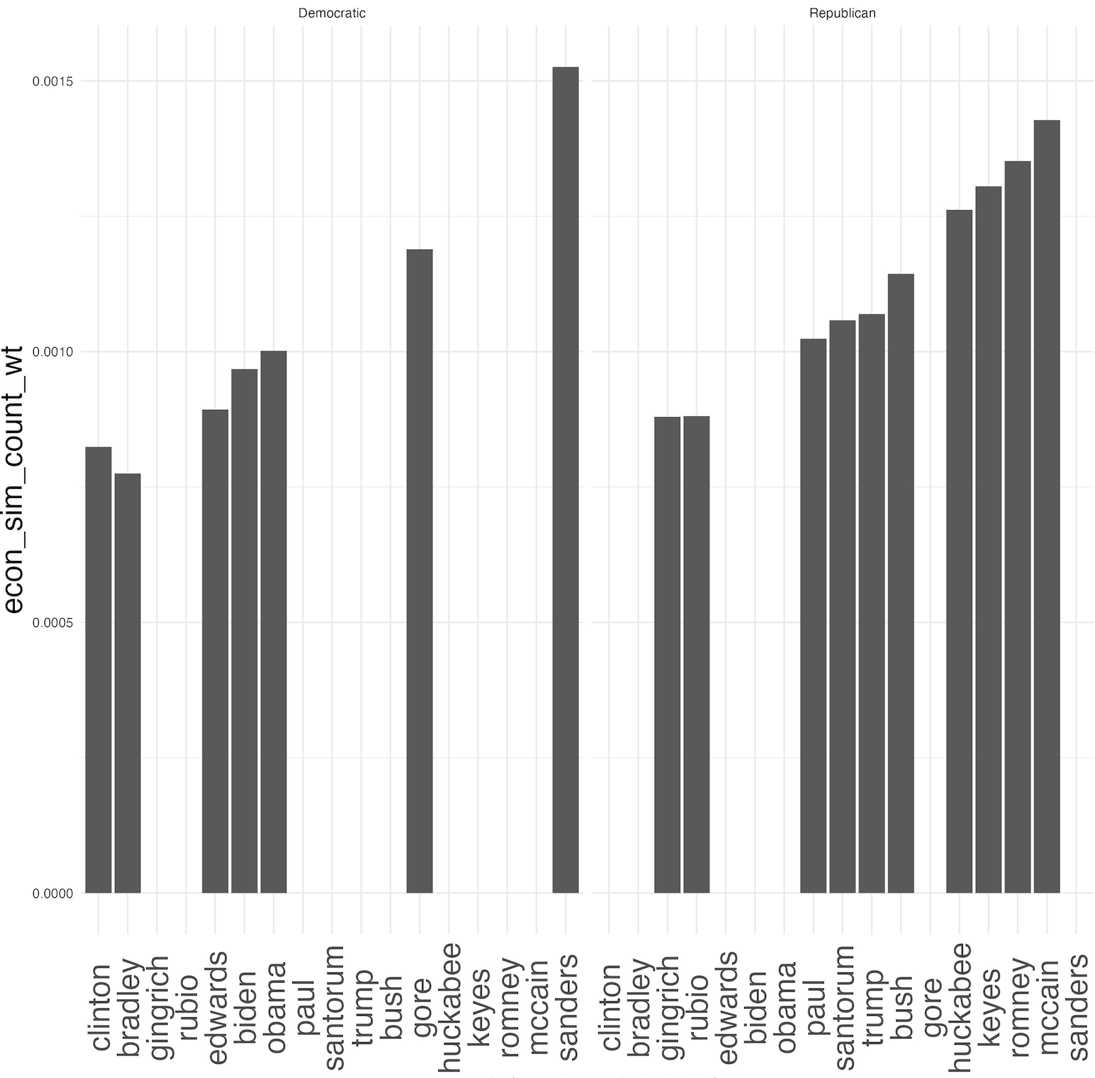
Wealthy + Elite

Slide 25
Next Steps:
Analyze by candidate (requires more cleaning)
Try more “concept” combinations

